Slide 1
WiFi Pineapple
Pwn by accident

Slide 2
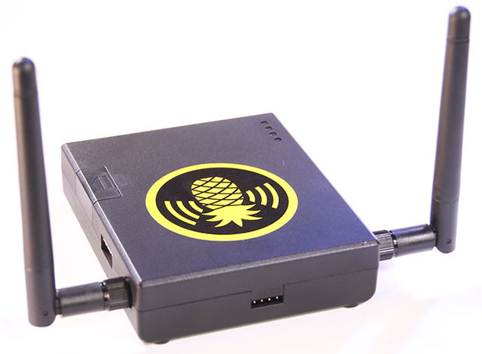

What is a WiFi Pineapple

Slide 3
What is a WiFi Pineapple
A simple router system with two open wireless chips that can be used for raw packet injection.
Has one ethernet port and a USB port that can be used for storage, another wireless interface, GPS, or a cellular modem.
The Pineapple can be used for recon or for active pentests.
Notes:
The WiFi Pineapple can be used to test any communication channel, This can be helpful on active pentests or testing applications because you can become a man in the middle and see the communication to test its encryption.

Slide 4
What is a WiFi Pineapple
Open hardware/open design
Atheros AR9331 IEEE 802.11 b/g/n
Realtek RTL8187 IEEE 802.11 b/g
Digital I/O pins which allow for expansion.
A HDK which is an Arduino Pro based microcontroller board.

Slide 5
What is a WiFi Pineapple
Users can make Infusions to extend the functionality of the WiFi Pineapple.
Infusions are small programs that allow the user to get and display specific information about the WiFi Pineapple, APs, or clients.
Infusions make up the GUI for the WiFi Pineapple.

Slide 6
How to use a WiFi Pineapple
Reconnaissance
Scanning
Gaining Access
Maintaining Access
Clearing Tracks
Used to see nearby Access Points (AP) and clients
Can see if a client is using an AP
Gives you basic information about APs (channel, signal strength)

Slide 7
How to use a WiFi Pineapple
Reconnaissance
Scanning
Gaining Access
Maintaining Access
Clearing Tracks
The WiFi Pineapple can scan the surrounding environment for signals
This can detect individual APs, signal strength, MACs, security setting, and other general info.
The reconnaissance on the WiFi Pineapple can tell if a client is attached to a specific network.

Slide 8
How to use a WiFi Pineapple
Reconnaissance
Scanning
Gaining Access
Maintaining Access
Clearing Tracks
Karma is a tool to make an evil twin AP by using the WiFi beacons that devices send out.
SSLstrip will take out SSL connections and view web traffic in clear text.
WiFi Deauth

Slide 9

How to use a WiFi Pineapple
Reconnaissance
Scanning
Gaining Access
Maintaining Access
Clearing Tracks
SSLstrip

Slide 10
How to use a WiFi Pineapple
Reconnaissance
Scanning
Gaining Access
Maintaining Access
Clearing Tracks
Can easily be hidden for long term deployment.
In discrete objects to remain unnoticed.
Can be combined with a battery when a power supply isn’t available.
Can add a 3G modem for remote management.

Slide 11

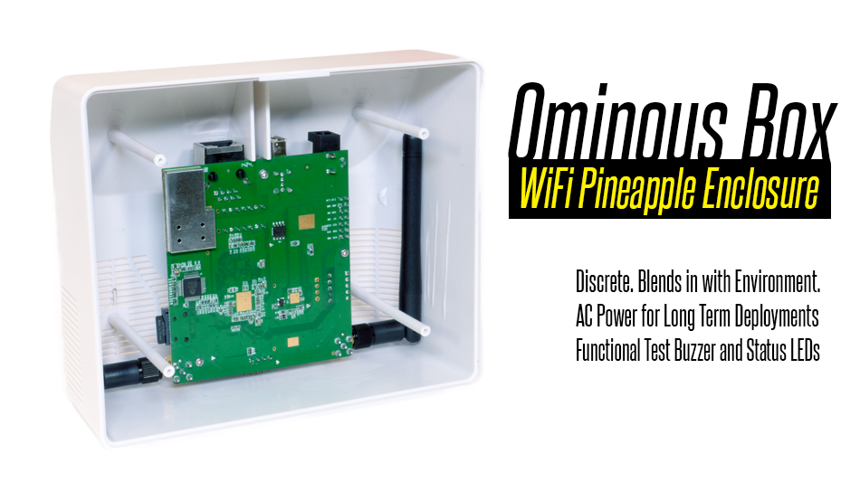
How to use a WiFi Pineapple
Reconnaissance
Scanning
Gaining Access
Maintaining Access
Clearing Tracks

Slide 12
More Info
Purchase:
https://hakshop.myshopify.com/
Support:
https://www.wifipineapple.com/
http://wiki.wifipineapple.com/
https://forums.hak5.org
Youtube

Slide 13

Demo
Notes:
What to go through in the demo
Before the presentation
Setup two computers (Victim and monitor), one router or hub and the WiFi Pineapple.
Connect the WiFi Pineapple to an AP.
Connect the victim computer to an AP.
Connect everything to the router or hub and setup a separate wired network for the three devices.
Connect the monitor computer to the victim and WiFi pineapple.
Deauth
Show the MAC addresses of the two computers, WiFi Pineapple, and the AP the victim is connected to. On Windows the “$ netsh wlan show interfaces” command with give the APs info.
Switch to the view of the WiFi Pineapple and send the Deauth to the victim to have it reauthenticate with the WiFi Pineapple.
Switch back to the victim and show the APs info again using “$ netsh wlan show interfaces”. This should be the WiFi Pineapple now.
SSLstrip
Once the victim is connected to the WiFi Pineapple navigate to twitter or some other site with a login.
Show the secured HTTPS portion.
Switch to the WiFi Pineapple Startup SSLstrip.
Go back to the victim and reload the site.
Show that no HTTPS is present.
Enter a username and password (johndoe lamepassword).
Switch to the WiFi Pineapple and show the username and password.

